Slide 1
FATIGUE OF MATERIALS & STRUCTURES
G. Hénaff
1

Slide 2
CYCLIC DEFORMATION & LOW CYCLE FATIGUE

Slide 3
Stress-strain behaviour under monotonic tensile loading
Ramberg-Osgood law:

Slide 4
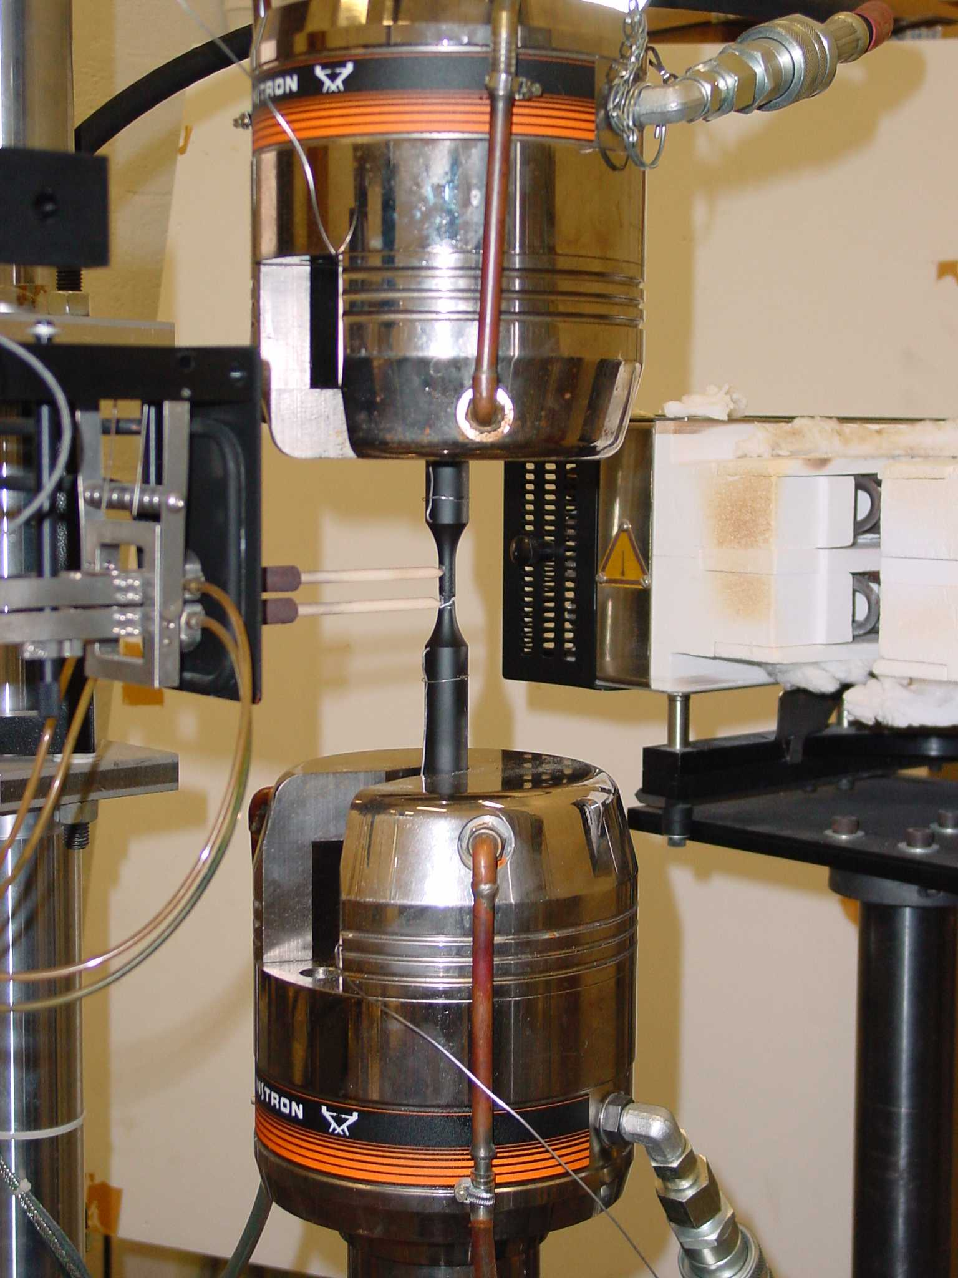
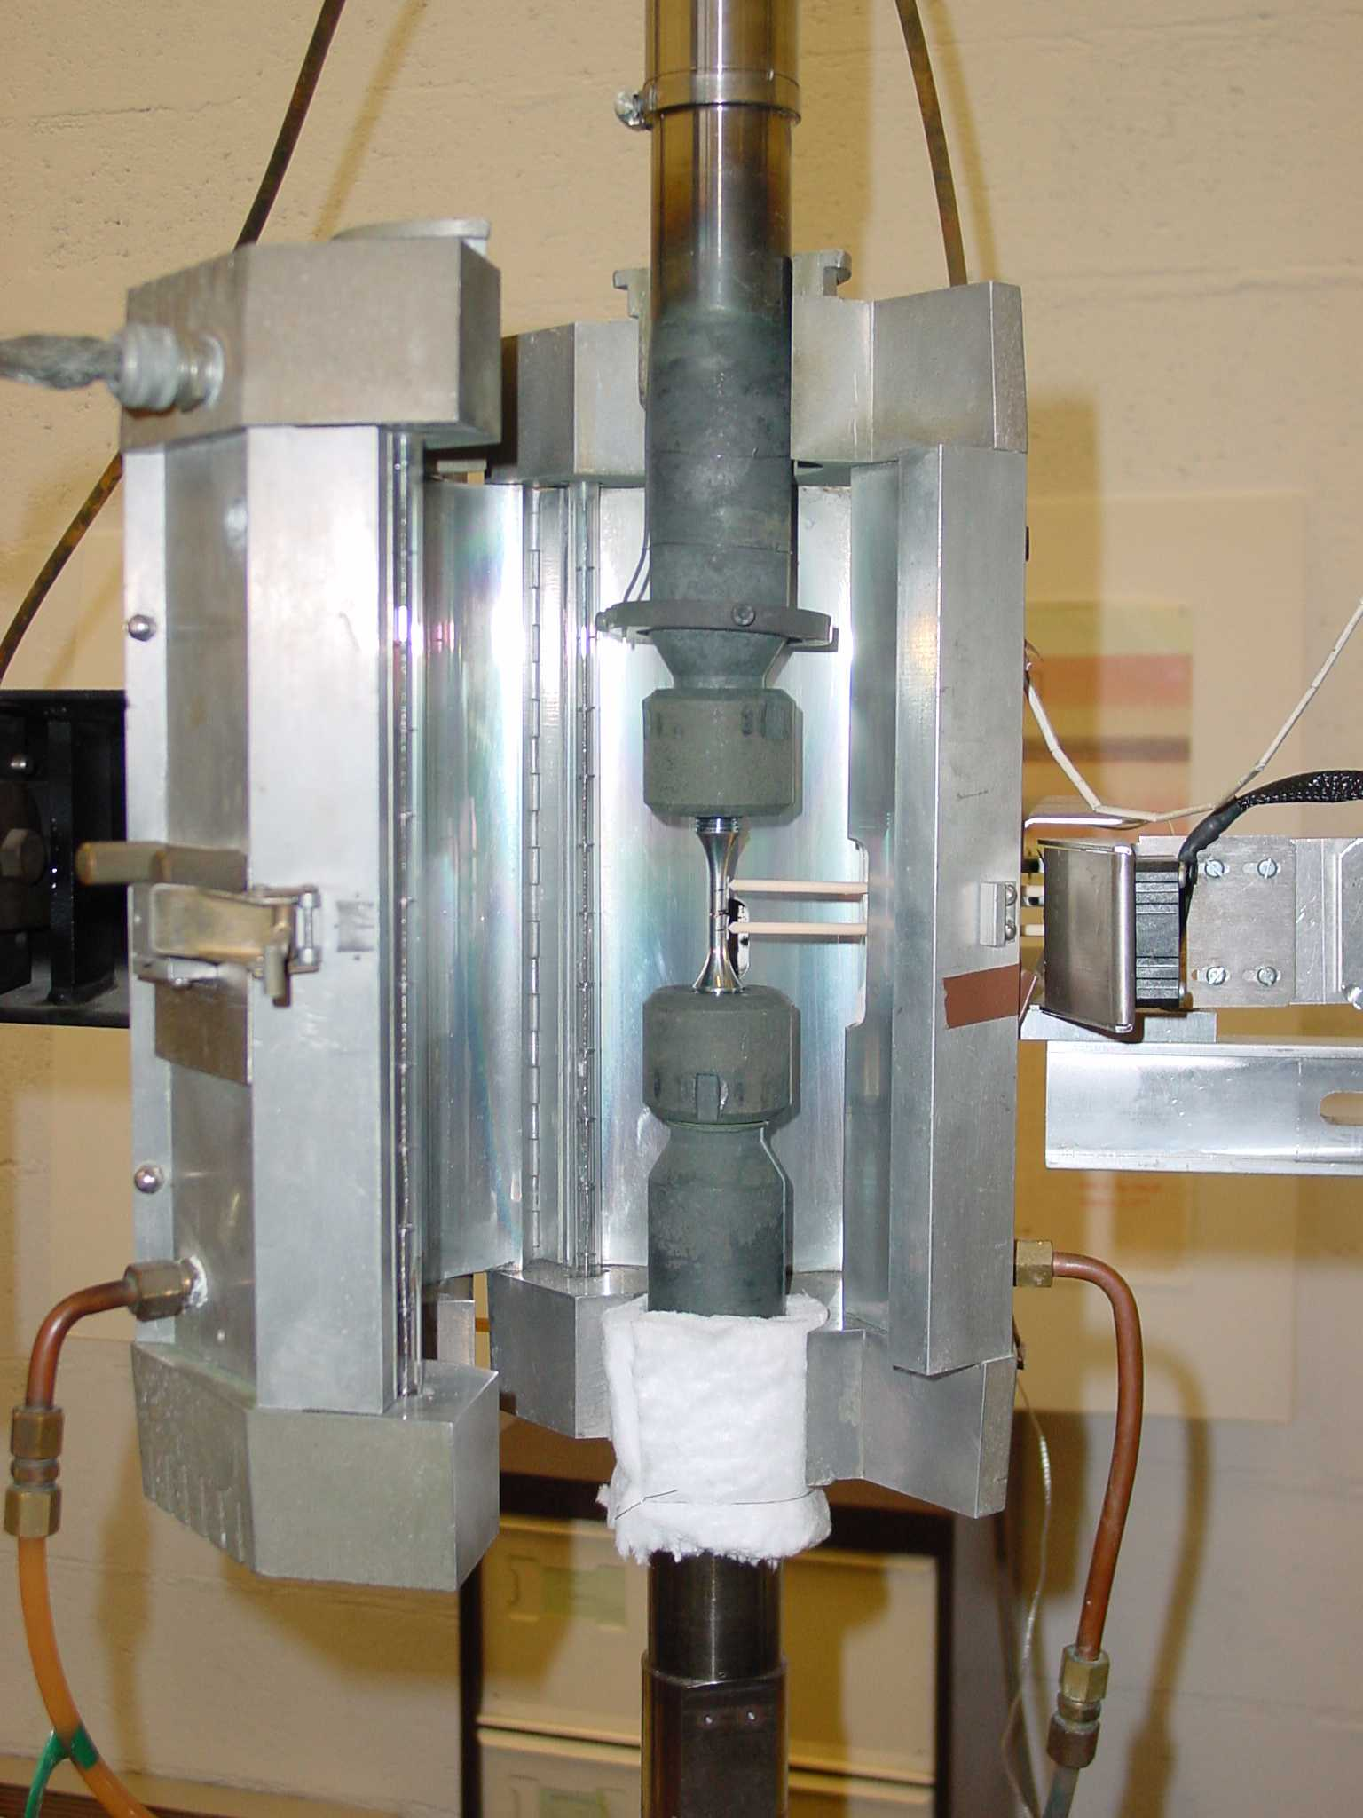
Cyclic deformation test

Slide 5
Hysteresis Loops
σ
ε_{t}
ε
-ε
t
ε
- ε
Control Signal
Material response

Slide 6
Hysteresis loop parameters

Slide 7
Hysteresis loops in a polycristaline copper

Slide 8
Cyclic stress-strain behaviour

Slide 9
Cyclic stress-strain behaviour of an austenitic stainless steel
Hardening
Softening
Stabilisation

Slide 10
Cyclic Stress-Strain Curve
The extrema of the stabilised hysteresis loops are plotted in a σ-ε plane for different strain amplitudes
σ
σ
σ₂
σ₁
Cyclique
ε
ε₁
ε₂
ε

Slide 11
Cyclic stress-strain curve (1)

Slide 12
Cyclic stress-strain curve (2)

Slide 13
Bauschinger Effect
σ_{F}
Stress
Permanent softening
σ_{R}
Reduced yield strength after load reversal
σ_{B}
Traction
Compression

Slide 14
Bauschinger Effect : « composite » model

Slide 15
Deformation substructures
copper single crystal

Slide 16
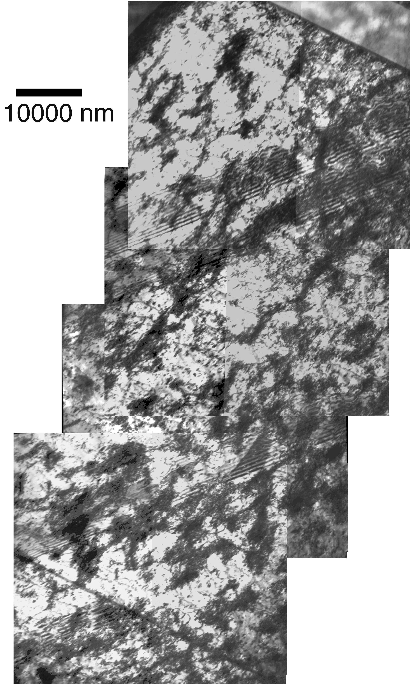
Vein-like structure
Walls (high dislocation density)
Channels
Ti-48Al-2Cr-2Nb Alloy

Slide 17
Different hardening mechanisms in precipitation-hardened alloys

Slide 18
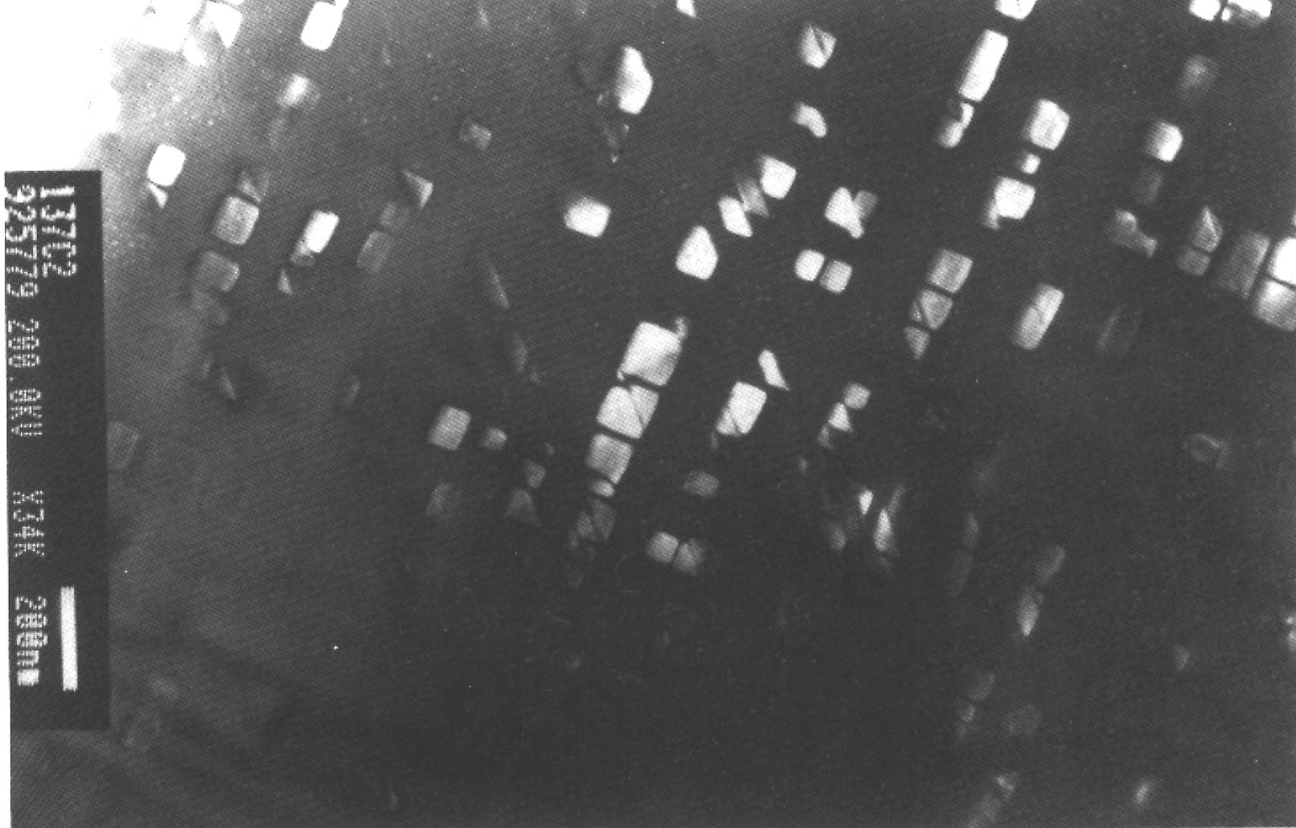
Precipitate shearing
Ni-15% Al

Slide 19
Influence of slip mode
Planar slip
Cross slip
Cells
Tangles
Mixture
Planar arrangements
N
f
Δε_{p}
10
10
10
5
6
7

Slide 20
Memory effect
Monotonic predeformed
Monotonic predeformed
Cyclic predeformed
cyclic
Stress σ, Δσ/2
Cyclic annealed
Stress σ, Δσ/2
Monotonic annealed
Monotonic annealed
ε
ε
Deformation ε_{p}, Δε_{p}/2
Deformation ε_{p}, Δε_{p}/2
(a)
(b)

Slide 21
Low-cycle fatigue life
Manson-Coffin :
Stress
Log Δε_{p}
E
Δσ
Δε_{p}
Deformation
Log N_{f}

Slide 22
Energy approaches
Loop area

